Slide 1

DEVELOPER REFERENCE
Git Command & Workflow Cheat Sheet
Essential commands, branching models, stash operations, and remote repository synchronization.

Slide 2
01 / ARCHITECTURE BASICS
Core Git Building Blocks
Commit
Branch
Tag
HEAD
Snapshot state of codebase.
Pointer to specific commit.
Permanent named reference pointer.
Active working directory pointer.

Slide 3
02 / SETUP & INITIALIZATION
Configuration & Repository Creation
Global Configuration
Starting Repositories
git config --global user.name "Name"
git init [project-name]
Initialize local repository
git config --global user.email "mail"
git clone
git config --global color.ui auto
Download repository with full history

Slide 4

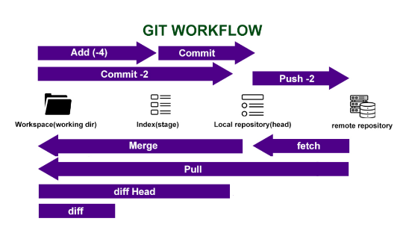
03 / DAILY WORKFLOW
Staging, Inspecting & Committing
git status
Display working directory state
git add [file]
Stage modified file for commit
git diff --staged
Show staged changes versus HEAD
git commit -m "msg"
Create permanent snapshot commit

Slide 5

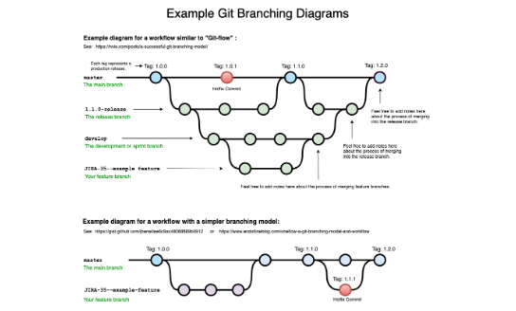
04 / BRANCHING MODEL
Branching, Switching & Merging
git branch [branch-name]
Create isolated branch pointer
git checkout -b [name]
Create and switch working directory
git merge [branch-name]
Integrate target branch into active branch
git rebase [target]
Apply commits onto linear target HEAD

Slide 6



05 / WORK PRESERVATION
Storing Work in Stash
git stash
git stash pop
git stash drop
Save Stash
Pop Stash
Drop Stash
Shelve active uncommitted modifications safely.
Restore latest stashed changes and clear entry.
Discard specific shelved changes permanently.

Slide 7
06 / AUDIT & HISTORY
Commit History & Reflog Inspection
Commit Timeline Log
Local Operations Journal
git log -n [count]
git reflog
git log --oneline --graph
Records all checkout and commit updates locally.
Visual timeline of merged repository commits.

Slide 8
07 / UNDO OPERATIONS
Resetting & Reverting Changes
SAFE NON-DESTRUCTIVE
DESTRUCTIVE RESET
git revert [commit-sha]
git reset --hard [target]
Creates inverse commit safely without modifying previous history.
Discards uncommitted changes instantly. Easy to lose work.

Slide 9
08 / REMOTES & RULES
Remote Sync & File Ignoring
Remote Synchronization
Ignoring Files (.gitignore)
git fetch [remote]
/logs/*
!logs/.gitkeep
/tmp
*.swp
git pull [remote]
git push -u [remote] [branch]
Excludes matching path patterns recursively.

Slide 10
RESOURCES & INSTALLATION
Ready to Master Version Control
sudo apt-get install git
Read the official Pro Git book online for free at git-scm.com/book.

Slide 11


Image Sources
https://media.geeksforgeeks.org/wp-content/cdn-uploads/20210401194608/GIT-WorkFlow.png
Source: www.geeksforgeeks.org
https://user-images.githubusercontent.com/1256329/80170009-f9d03200-85b4-11ea-94d3-3041887565ac.png
Source: www.bryanbraun.com

